Slide 1
The Meadows at Topsfield
Community Meeting October 7, 2019
Topsfield Library 5:30PM
Pat, Sandy, Scott, Su and Tim

Slide 2



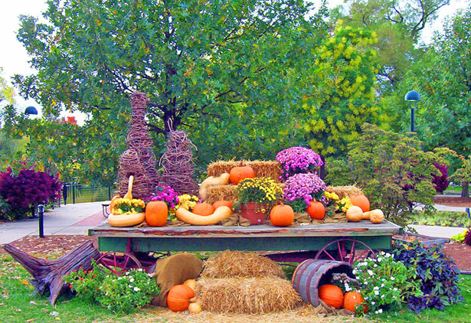




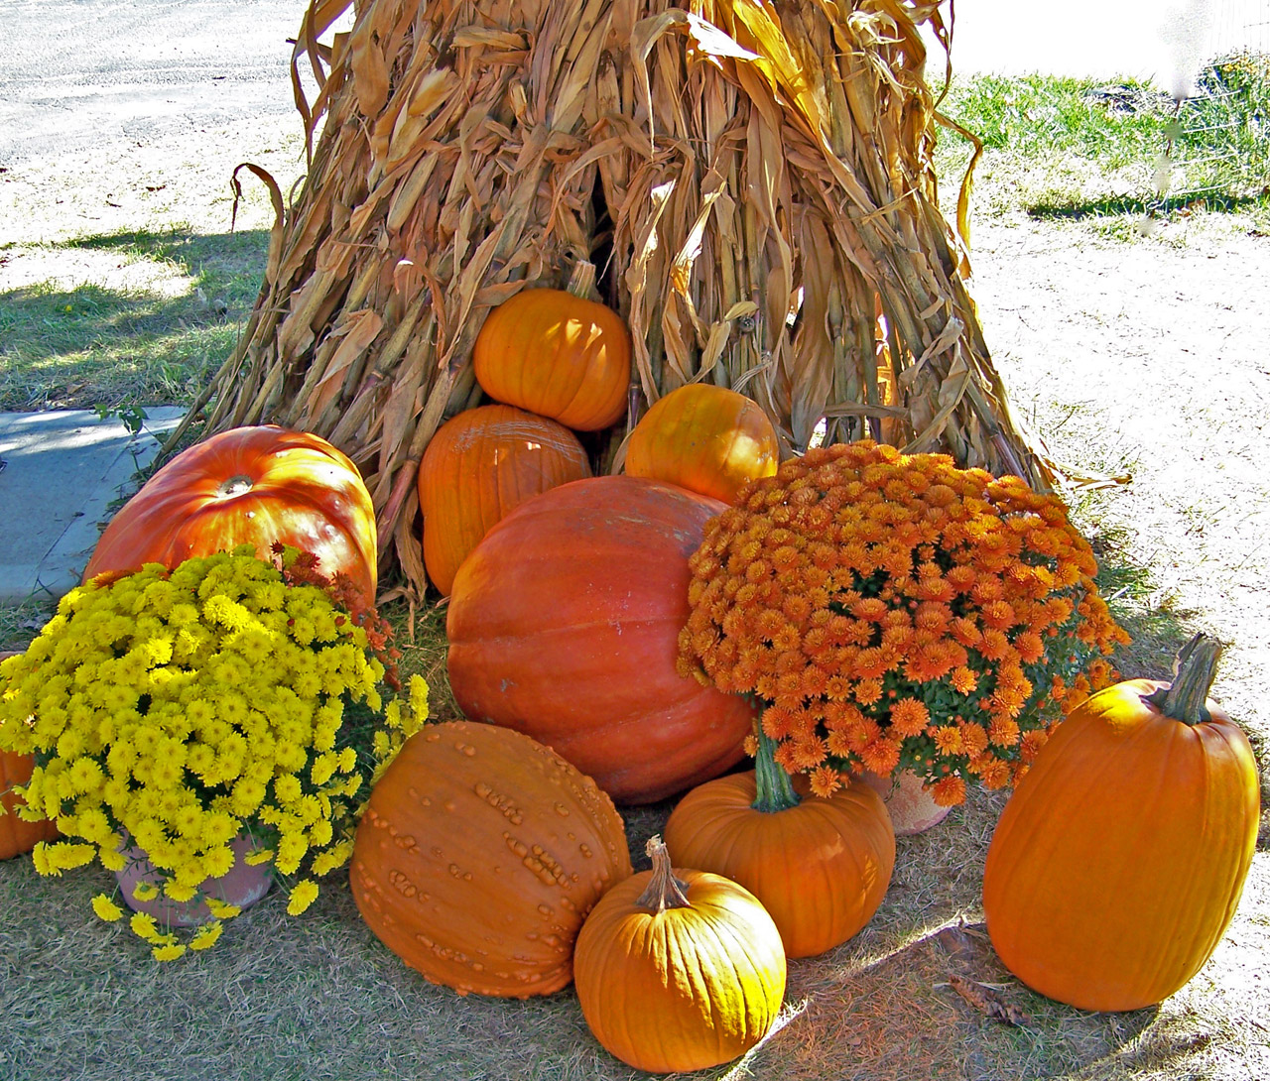

WELCOME
WELCOME

Slide 3
Agenda
Website Introduction
Maintenance Update
  Landscape
  Infrastructure (Buildings etc.)
All Things Financial
  YTD summary of 2019 Cost Trending
  Targeted 2020 HOA
  Reserve Funding Recommendation (% value)
  Community Feedback for add-ons
Guidelines Review (AKA By-Laws Cliff Notes) and Community Feedback
Voting (November Time Frame)
  Board Seat opening January 1
  Change By-Laws to 2 year terms
Holiday Party Announcement
Q&A

Slide 4
The Meadows At Topsfield Website
Su

Slide 5
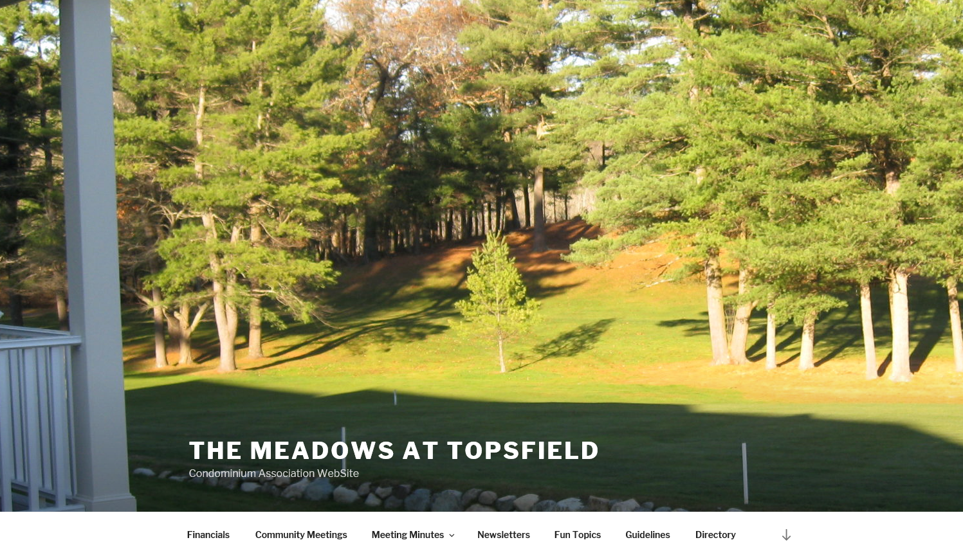
Access by going to: http://meadowstopsfield.com

Slide 6
Around the Grounds
Tim

Slide 7
Maintenance Report
Maintenance Completed:
Septic
Septic Pumping Complete
Installation of commercial filters – a cost savings improvement long term
Golf Ball Damage
Windows: Multiple Replacements
Siding – Multiple Damaged Panels
Touch Up Painting
Building Maintenance:
Reworking of roofing to units 23 and 8
Replacement of rotting wood. Multiple units
Maintenance Pending
Pavement –Schulte had scheduled for this week
Golf Net - New net between Units 20 and 21 requires repair – T&R Construction will facilitate
Skylight - Scheduled pending receipt of the window (Unit #11)

Slide 8
Landscaping Report
New Vendor: Servizio Landscape and Snow Removal
Fall Grounds Work Complete
Crab Grass Treatments
Bluegrass seeding – resulting in greener lawns over time
Fall Grounds Upgrades Complete
New Plantings and grooming behind Units 21 – 24 (no impact to the Community Budget)
Landscape Professional walkaround
Fall Grounds Upgrades Pending
Long term landscape strategy plan in progress
Water Shutoff and Cleanout
Pruning, Weeding, Fall Prep

Slide 9
ALL THINGS FINANCIAL
Scott

Slide 10
State of the Association (Financials) and Trending – September 2019

Slide 11
Projected 2020 HOA Budget
 |  |  | Estimated
Item | 2019 Budget | 2019 Projected | 2020 Budget
Landscaping and Tree Service | $36,015 | $34,842 | $24,775
Landscaping and Tree Service (added landscaping) | NA | NA | $6,600
Snow Removal | $23,912 | $17,130 | $32,500
Insurance | $19,392 | $21,228 | $21,000
Repairs/Maintenance/Gutter Cleaning/Painting | $13,500 | $15,000 | $15,000
Septic Maintenance and Pumping | $2,900 | $3,775 | $4,000
Sprinkler/Fire Alarm Testing/Maint. | $5,200 | $2,969 | $4,000
Telephone (septic/alarms) | $2,100 | $2,421 | $2,400
Professional Fees | $2,000 | $866 | $1,000
Electricity and Water | $1,900 | $2,142 | $2,200
Miscellaneous | $3,000 | $312 | $1,000
Golf Net Replacement | $2,500 | $2,500 | $1,500
Tree Plan | $8,510 | $8,500 | $0
Computer System for Accounting | $1,500 | $0 | $0
Reserve (10%) | $13,547 | $13,547 | $20,000
TOTAL | $135,976 | $125,232 | $135,975
Contingency (Golf Net, Laptop, Bldg. Drip Edge Replacement) |  | $10,744

Slide 12
Recommended Reserve Funding
2019 funding will reflect an increase of $8,510 – Tree Loan repayment
2020 will fund the reserve with an extra ~$6,500 – Contribution rate of ~40%
  This level of funding should reflect the amounts necessary to meet all of the spending commitments detailed in the reserve study

Slide 13
COMMUNITY SUGGESTIONS FOR IMPROVEMENTS
Thanks to you all for your thoughts:
Several suggestions received from community members
Board wants 2 years of “Within Budget” tracking before discussing implementation of “Extras” other than Landscaping (Priority #1)
Consideration: Some may be viable for the 2020 Budget pending further review/discussions (Entry Plantings)

Slide 14
COMMUNITY GUIDELINES
AKA - (BY-LAW CLIFF NOTES)
Su

Slide 15
GUIDELINE FEEDBACK BY THE COMMUNITY
“Cliff Notes” overview summarized directly from our By-laws and Handbook
Most were pretty Black and White
Some required the Boards Practical Interpretation of the By-law referenced
  If there are specifics identified by the community that require discussion we are more than flexible to revisit
  Suggestions will be provided to the community
Inadvertently left out parking. That will be updated shortly and redistributed
If changes seem to be required based on the majority, we will address at the May 2020 Community Meeting
Community Thoughts?

Slide 16
LOOKING AHEAD – BOARD POSITION
Su

Slide 17
Looking Ahead – Voting
Board Position
One Board Position opening January 1, 2020
Voting to take place Mid November
2 year position
Approval for 3 year term – for this term only
Several members of the Board have agreed to extend this current term to 3 years per our by-laws with community approvals. Voting was for 2 year terms in error. Do we need a question on the ballot to accommodate this?
Approval to change by-law to 2 year terms – here going forward
The community needs to approve changing the by-laws to 2 years. It is the opinion of the Board that this will make it easier and more appealing for people to step up and serve

Slide 18
HOLIDAY PARTY
Su

Slide 19




Holiday Party – Saturday December 7th
5:30PM
Appetizers: Su and Richie – Unit #22
Desserts: Jane – Unit #18
This Photo by Unknown Author is licensed under CC BY-NC

Slide 20
Clarifications and Questions??????

Slide 21
Thank You All!!!!!!!

