Slide 1
The Meadows at Topsfield
Community Meeting May 29, 2019
Topsfield Library 5:30PM
Pat Grant, Sandy Guido, Scott Hurley, Su Comeau and Tim Pudvah

Slide 2
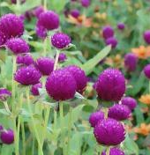


WELCOME
WELCOME
WELCOME

Slide 3
Agenda
The Meadows at Topsfield Mission Statement
Trustee Appointment Terms
Website
Maintenance Report
Landscape Report
HOA Reminder - Thank You
State of the Association (Current Financials and Trending)
New Automated HOA Payment Process
Looking Ahead
Clarifications and Questions

Slide 4
OUR MISSION - OUR BOARD
Sandy Guido

Slide 5
Mission Statement
Vision Statement:
To Create and Foster Excellence in Community, Environment and Quality of Life
Values:
We value integrity, fairness, and respect for all
We value transparency
We value community input and volunteerism
Mission:
Our mission is to enhance and preserve the quality of life and sense of community through effective and efficient management of the Association, to consistently enforce rules and covenants to preserve property values, and to support initiatives and capital improvements that benefit the greater good of the community
Strategic Planning:
We believe that efficient allocation of scarce resources requires a strategic plan to be developed on an annual basis before the budgeting process
Spending priorities should align with the long- and short-term strategic goals of the community
Homeowners are encouraged to be a part of the strategic planning process

Slide 6
Trustee Terms
Trustee Appointed Terms……………………………
One seat is expiring December 31 of this year. We are asking neighbors to consider running for that replacement seat. Term will start January 1, 2020.
The Community has voted Trustees in for 2-year terms. Our By-laws mandate 3-year terms.
Option 1: Current Trustees have agreed to serve 3 years with community approval
Option 2: Modify the By-laws to allow for 2-year terms
Note: We will add an item to the November election ballot seeking community approval to expand the current Trustees’ terms to 3 years.

Slide 7
The Meadows At Topsfield Website
Communication Opportunity
Thank You Lucy Power

Slide 8



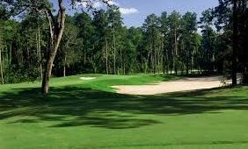




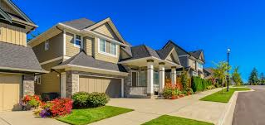
The Meadows at Topsfield Website

Slide 9
The Meadows at Topsfield Website
Mission Statement & Documents:
Meeting Minutes, Legal Docs, Handbook, Community Newsletters, Approved Floral Plantings etc.
Project Status Updates:
By-law Amendments - Complete
Preference Lists – Complete
Items of Interest:
Recommendations for Service Providers (Plumbers, Electricians, Rug Cleanings etc.)
Events:
Book Club, Coffee Cake Club, Follies, Holiday Party, Inspections, Window Washing, Deck Washing
Personal Interest:
Recent Trips, Funny Stories, Links to Interesting Topics, Welcome to the Neighborhood, Welcome to the World

Slide 10
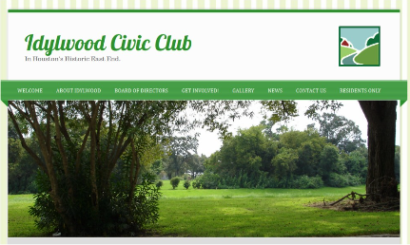
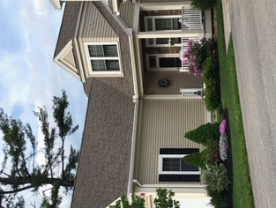
Website Example

Slide 11
Around the Grounds
Tim Pudvah

Slide 12
Maintenance Report
Scheduled Maintenance:
Septic
Septic Pumping
Installation of commercial filters – a cost savings improvement long term
Golf Ball Damage
Window replacements
Siding – Damaged Panels
Golf Nets – Partially repaired for now behind Units 21 - 24
Touch Up Paint
We have Touchup Paint available for minor touchups – See Tim
Pavement
Landscape Vendor will be sealing cracks shortly
Completed Maintenance:
Power Washing Buildings 2, 3 and 4 (our oldest buildings)
Lawn Sprinkler Replacements/Irrigation (Association Wide)

Slide 13
Landscaping Report
Spring Grounds Work – Rehabilitation
Lawn irrigation system
Slice seeding in the front of and across from Units 1-8
Fungicide application to lawns
Spring Grounds Upgrades
Planting perennial flowers instead of annuals
Planting beds around lamp posts
Plantings in the drainage swale and around the golf nets behind Units 21 - 24

Slide 14
ALL THINGS FINANCIAL
Scott Hurley

Slide 15
HOA REMINDER
Thanks to you all:
HOA Payments are now being received at the beginning of the month
It’s a great help with respect to paying bills in a timely fashion
It’s a great help to us personally, allowing us to update financials only once a month
P.S. The Condo Box is now fixed. You can put your checks in the slot and we can retrieve them out of #25 anytime. Thanks Bob, Richie and Mr. Mailman

Slide 16
State of the Association (Financials) and Trending – May 2019

Slide 17
New Automated HOA Payment Process
We are still working with TD Bank to finalize the process
We will communicate to the entire association as soon as the details are complete

Slide 18
LOOKING AHEAD - STRATEGIC PLANS
Su Comeau

Slide 19
Looking Ahead
Short and Long Range Strategic Community Planning
Goal: Maximize Positives and Minimize Negatives - We will start the process in June by:
Researching cost-saving opportunities, such as, but not limited to……..
  Reviewing existing vendors and policies
  Utilizing smarter building materials
  Integrating smarter planting selections into the association landscape plan
  Researching interest bearing accounts for our Reserve and Contingency Funds
Researching Industry Standards/Recommendations for % funding of our Reserve
Soliciting suggestions from the community
Surveying all unit owners to determine the community's priorities before developing the 2020 budget

Slide 20
Clarifications and Questions??????

Slide 21
Thank You All!!!!!!!

